Slide 1
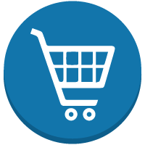
Blockchain Technology in Retail Industries

Slide 2
Executive Summary
The global market for blockchain technology in retail is expected to reach USD 20 billion by 2024. The blockchain technology usage is still in its nascent stages in the retail sector but is expected to gain traction in the next few years.
Strategic initiatives by key players, increasing demand to reduce product counterfeit, streamline business process such as payment & order management, supply chain operations ,inventory & database management are a few major factors driving the market growth.
However, lack of awareness of the blockchain technology along with uncertain regulatory and compliance standards may hamper the market growth.
Market Overview
North American region dominates the market as the US, Canada and Mexico are the early adopters of the block chain technology. Many retail companies in this region use this technology to improve efficiency in their daily operations.
Retailers in Europe are implementing cryptocurrencies to promote cross-border trade in the region. The market is expected to witness substantial growth in the coming years. Similary, the Asian markets are expected to have a higher growth over the next few years due to large scale adoption of blockchain technology in e-commerce firms and fashion brands.
Regional Analysis
Industry Analysis
The blockchain technology are available to users through various platforms such as Bitcoin, Ripple, Ethereum, R3 Corda, Hyperledger Fabric, Multichain, Quorum and others.
The top companies in this technology keep innovating in R&D to maintain a cost-effective portfolio. There are mergers & acquisitions among major players that are helping to strengthen the company product portfolio and also increase their customer base.
Major Players in the market
IBM, Microsoft, Oracle, SAP, Amazon Web Services, Bitfury, Cegeka, Coinbase, Blockpoint Systems, Abra, Bitpay, Project Provenance, BTL group, Recordskeeper, Bigchaindb, OGY Docs, Cisco Systems, Inc, Tata Consultancy Services Ltd., Coin Sciences Ltd., Cognizant, Auxesis Group, BlockApps,R3 are some of the key players operating in the market.

Slide 3
Blockchain Technology: Advantages for the Retail Sector
Blockchain uses in the retail sector
Blockchain, also known as ‘distributed ledger technology’ (DLT), allows participants in a distributed network to maintain a copy of an unchangeable ledger of transactions as well as allow smooth transactions without any third-party assistance.
This facilitates retailers to track the origin of stock assuring for food safety and also helps in identifying low-quality suppliers using poor ingredients.
Blockchain is disrupting the retail industry
Companies will need to integrate their blockchain ledgers with existing ERP,CRM, finance and asset management systems when SAP or Oracle announce a new version of their software.
Most MNCs in the US such as Walmart are using blockchain for its food safety program in collaboration with IBM. This is done to enable all green leafy vegetable suppliers for Sam’s and Walmart to upload data and track their corporate blockchain ledger without any kind of manipulation.
Similarly, Amazon has launched it Amazon Web Services (AWS) that offers a fully-managed service to maintain scalable blockchain networks using open-source networks such as Ethereum and Hyperledger Fabric.
The importance of Blockchain for the retail industry
The new age digitally- savvy shopper expects complete product information before purchasing. Blockchain technology presents an opportunity to create a decentralised, secured network data that businesses share with their customers in order to build trust.
This blockchain showcases the different stages of a product supply chain during manufacturing. Through this, shoppers gain access to trustworthy data about product authenticity while shopping online or in-store.

Slide 4
Value Chain Analysis - Model 2
Blockchain Technology for Retail : Notional Architecture
Supplier
Supplier
Customs
Blockchain Cloud Services
Customs
Aftermarket Manufactures
Retailers
ERP Cloud Services
Integration Cloud
Retailer
Distributor
Mobile Cloud Services
OEMs

Slide 5
Blockchain Technology: Use cases and growth opportunities for the Retail Sector
Product Provenance
Allows end-to-end transparency for the source of ingredients in the product, thereby allowing consumers to track their product from start to finish.
0
Fraud Prevention
Blockchains block counterfeit goods from reaching the market. For instance, a shoe manufacturer used blockchain technology and implanted smart tags in their footwear, enabling consumers to scan the smart tags with their smart phone and check for product authenticity. In another instance, De Beers diamond jewelers, a luxury brand retailer, have plans to introduce blockchain to track gems for authentication periodically.
Loyalty points
management
Digital wallets can be created using blockchain technology. This can be used to manage reward cards, loyalty points, paper and digital coupons.
Blockchain provides real-time liquidity to consumers, making loyalty points easily transferable between consumers and retailers.
0
Consumer data
Blockchain aids retailers in managing customer data with automatic compliance, thereby enabling smart contracts to govern permissions and allow access to consumer data. This helps in retailers managing data centrally, including audit trails that track the immutable data. The blockchain technology uses cryptocurrencies for exchanging data in a business context for cross-border payments and micro payments.
Smart contracts
Smart contracts makes use of blockchain to avoid inconvenience associated with collection of traditional transaction structures. For instance, automated refunds, instant payments and collections, automated insurance payment and settlement are a few applications of blockchain.
Notes:
Micro renewables

Slide 6
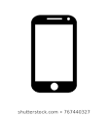
Value Chain Analysis - Model 2
Schematic diagram of tracking products in the Retail Industry using blockchain
Walmart, Starbucks, Carrefour, JD.com, and Amazon are a few big retail players to have started blockchain trials
Logistics Partner
Warehouse
Aftermarket Manufactures
Manufacturer
Retailer
Consumer
Tags the item
Scans the item while loading
Scans the item while receiving and handling inside the warehouse
Scans the item on receiving
Scans the product upon purchase
Mobile Cloud Services
OEMs
Every time the product changes hands, its location and other details are recorded on the blockchain.
Customer is redirected to retailer app and can see the product history and verify its origin based on the data received from the blockchain.

Slide 7
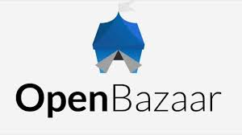
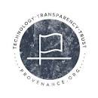
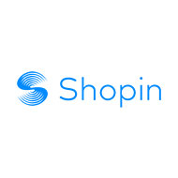
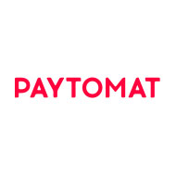
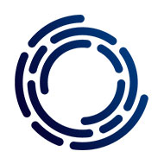
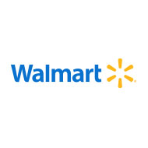
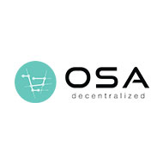
Blockchain in Retail: Companies to look out for in 2019
The blockchain technology in retail is still in the very early stages of adoption. Discussed below are a few companies that are trying to leverage blockchain technology for their retail clients by using distributed ledgers and cryptocurrencies for secured transactions across the supply chain ecosystem.
Founded in 2014, the company is one of the earliest entrants in the retail industry, providing a platform where users can transact with cryptocurrencies for a milieu of merchandise and services. Their aim is to offer a free online platform service where users can earn cryptocurrencies in exchange for their goods and services.
Founded in 2014, the company helps to raise retailer accountability while connecting with environmentally conscious consumers. Their aim is to kick start the practice of ‘green-washing’ by creating more comprehensive, blockchain powered solutions for retailers.
Founded in 2017, Shopin is a decentralized shopper profile that uses the blockchain platform to help consumers gain better insights while protecting consumer data from data breaches.
Founded in 2016, the company has a ready-to-install payment portal to assist retailers accept cryptocurrencies. The platform has been in use by more than 300 merchants- from beauty salons to medical clinics to restaurants.
Founded in 2017, Authoreon consists of an optical reader label linked to the blockchain to aid brands in authorizing their retail, to fight fake goods and improvise their supply chain management.
Walmart has bought Jet.com and numerous blockchain projects to help retailers implement blockchain technology in their mainstream operations. Their most successful pilot to date is a food provenance partnership with IBM.
OSA Decentralized provides AI-driven solutions to retailers, manufacturers, and consumers by collating fragmented data from across the supply chain and use machine learning to process, analyze, and clean it. Their smart contracts help protect interests of both data providers and consumers, as a unique set of KPIs, product ratings, and rewards are stored on the blockchain to secure them from manipulation.

Slide 8
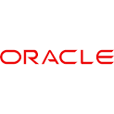
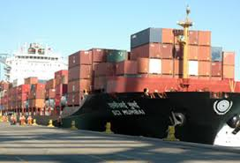
Oracle Blockchain services and applications in Retail
Supply Chain & Shipping
Challenges
Opportunities
Lot of paperwork involved in shipping of goods across the supply chain ecosystem. At times, mismatch of shipping documents can cause shipping delays leading to huge losses to retailers.
Cargosmart and Oracle Blockchain Transform shipping making sure when goods get disembarked and embarked on various ports,information gets recorded and the retailers exactly know the status of their goods.
Result
A top shipping company in Asia implemented this to track goods at various ports across the supply chain ecosystem. This provided to be hassle free as there was no paperwork involved and the information was transparent on the blockchain.
As the blockchain technology is still in its early stages of development, Oracle has partnered with UCLCRT and MONOCHAIN to launch a Retal Blockchain Consortium (RBC) specifically designed to advance the use of distributed ledger technologies within the Retail Industry. Working groups within the consortium include organizations spread across the retail value chain from fashion designers & luxury brands to grocery stores and manufacturers.
Track product usage of high-value assets for rental, warranty, service, and insurance. Provide undisputable records for leased product usage tracking and deliver an auditable and verifiable log of product usage for warranty and liability claims, resulting in reduced legal liabilities and increased customer satisfaction.
Oracle Intelligent Track and Trace
.....
Provides complete solutions to track and trace the movement of goods across trading partners. Create a digital paper trail for each step in the supply chain with prebuilt analytics to manage the operations.
Oracle Warranty Usage and Tracking
Oracle Product Lineage and Provenance
.....
Keep track of the product as it moves throughout the value chain and automatically captures information resulting in traceability and visibility of a product.
Oracle intelligent Cold Chain
Monitor the condition of goods from the manufacturer all the way to point of sale. Improve safety with a full track-and-trace solution for food and pharmaceuticals that require cold storage.
.....

Slide 9

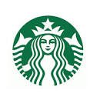
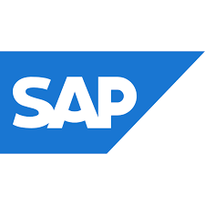

Microsoft Blockchain services in Retail
Starbucks Retail
Challenges
Opportunities
Each Starbucks store has more than a dozen pieces of equipment, that must be operational around 16 hours a day. A glitch in any of those devices can mean service calls that rack up repair costs. More significantly, equipment problems can potentially interfere with Starbucks’ primary goal of providing a consistently high-quality customer experience.
To reduce disruptions to that experience and securely connect its devices in the cloud, Starbucks is partnering with Microsoft to deploy Azure sphere, designed to secure the coming wave of connected internet of things (IoT) devices across its store equipment.
Result
Microsoft worked with Starbucks to develop an external device called a guardian module to connect the company’s various pieces of equipment to Azure Sphere in order to securely aggregate data and proactively identify problems with the machines.
The solution will also enable Starbucks to send new coffee recipes directly to machines securely from the cloud to Azure Sphere-enabled devices at the click of a button. Furthermore, the company is developing a feature for its mobile app that shows customers information about the sourcing details of the coffee and the effors Starbucks is undertaking to support farmers in those locations.
SAP Blockchain services in Retail
Challenges
Opportunities
Mislabeling of fish and fraud happens very commonly in the seafood retail industry. Studies published by Oceana, a marine conservation nonprofit organization, found that 1-in-5 fish tested by the group was not correctly labelled.
To overcome these challenges, retailers such as Bumble Bee are using blockchain technology supplied by SAP on a private distributed ledger called ‘multichain’ .
Result
Blockchain technology was a great fit for the seafood industry to minimize losses. As the supply chain involves many intermediaries ranging from safety inspectors to food processors to customs agents to grocery stores, participants were able to see and track real time data.

Slide 10
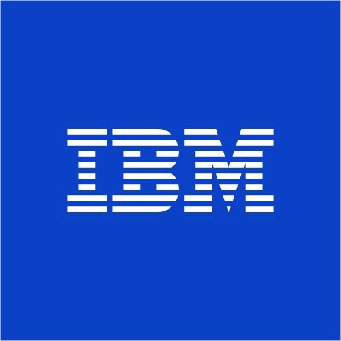
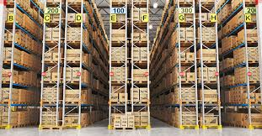
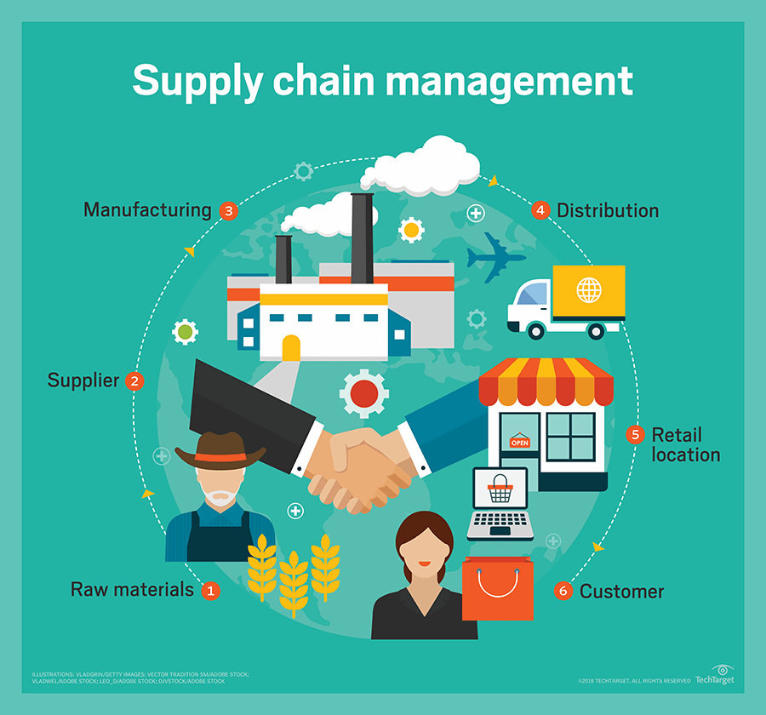
IBM Blockchain services in Retail
Commerce
Challenges
Opportunities
Prolonged payment and invoicing processes across diverse systems result in holding up of payments and verfication. This is leads to disputes increasing the cost of doing business.
IBM Blockchain aids in reducing conflicts in commerce by enabling a common chain of information that is visible and shared across the plaftorm by the vendors and buyers.
Result
A top consumer good company used IBM Blockchain to decrease the ambiguity they experienced in invoice processing.
This helped in reducing processing costs to half of the original amount. Looking at these positive results, the firm has interests in implementing this model to various other supplier relationships.
Supply Chain
Challenges
Opportunities
Disparate systems used by various entities across the supply chain stall visibility across the system leading to conflicts and risks. For instance, there is a lot of mistrust in the food supply industry because of no transparency between consumers, suppliers, distributors, logistics, and retailers.
IBM Food Trust offers solutions to these challenges by uniting farmers, distributors, processors, retailers and other food industry stakeholders to safely track food through various stages of the supply chain.
This IBM Blockchain offering helps to manage food safety from farm to store through data traceability and compliance certification.
Result
IBM and Walmart have collaborated to help improve food safety by using IBM Food Trust blockchain solution to run production data for items across the food system allowing adopters to safely share data with their supply chain partners.
Similarly,IBM and Maersk have partnered to modernize shipping with an efficient and safe global trade digitization platform through IBM Blockchain.

Slide 11
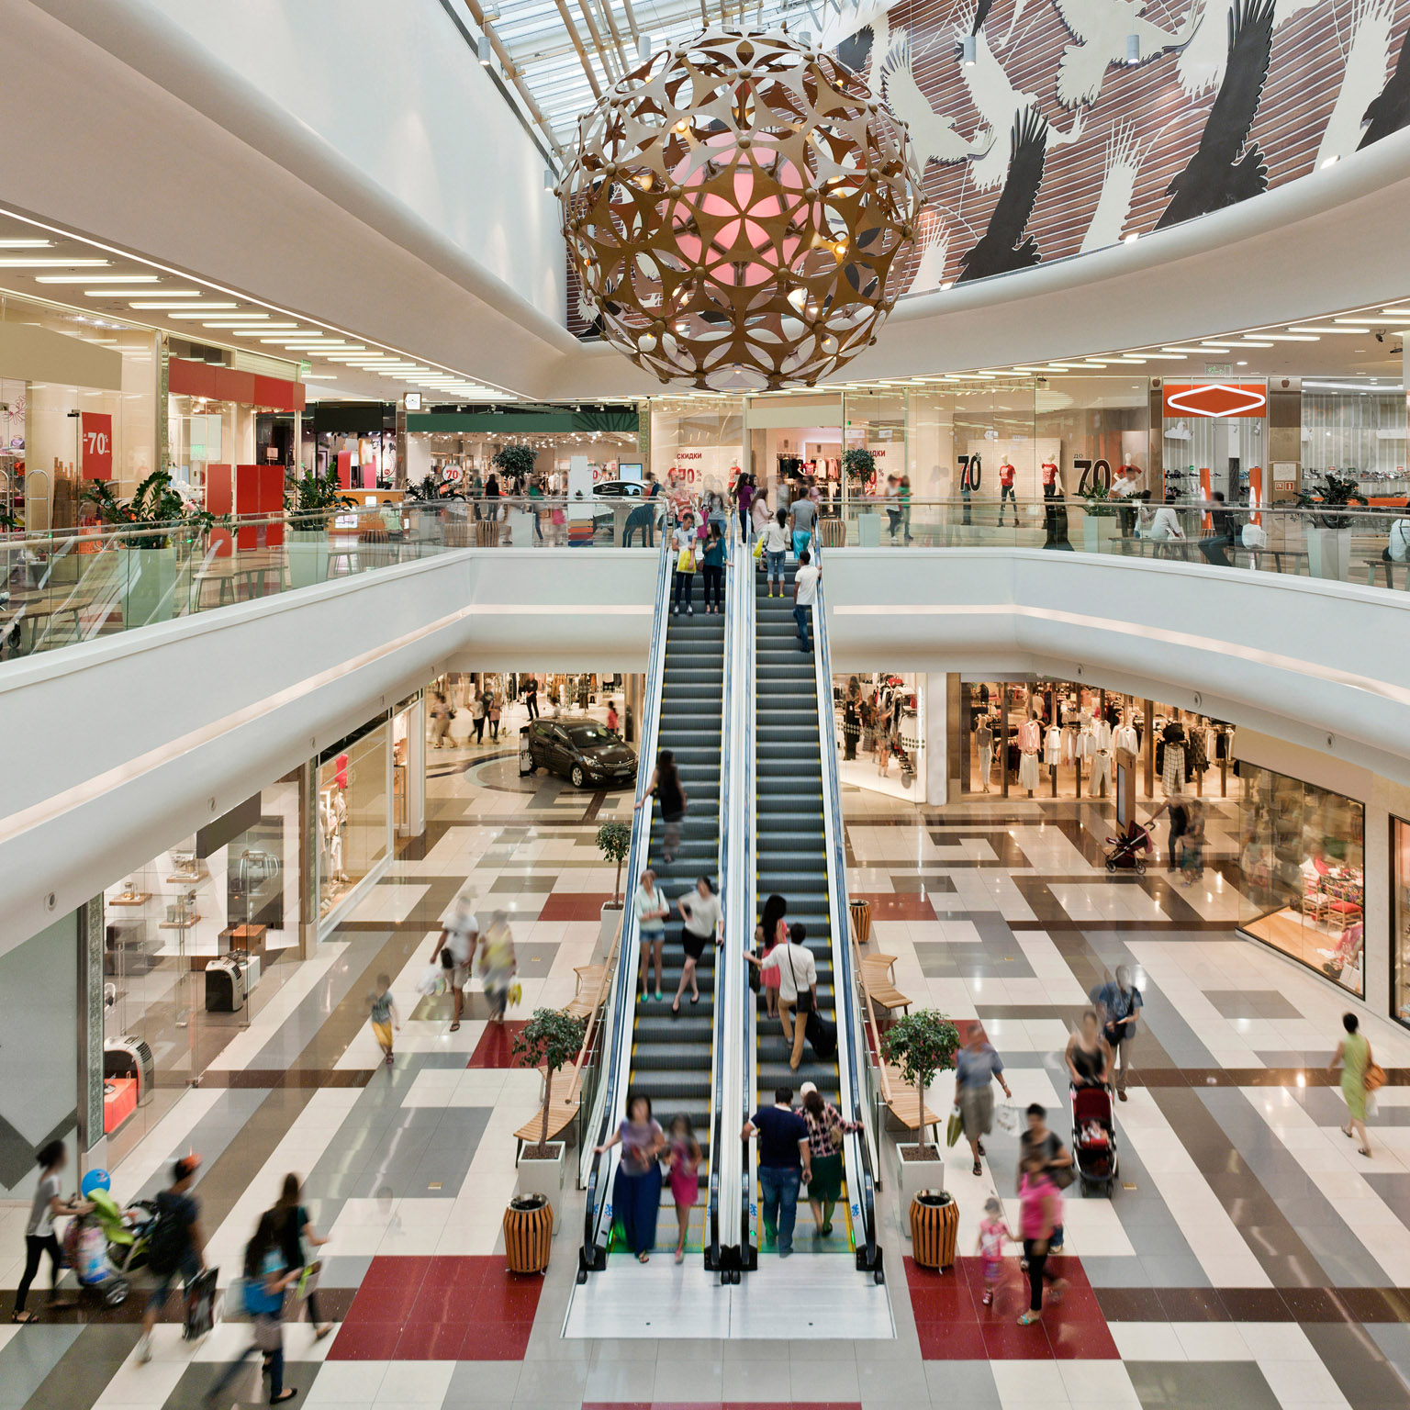
IBM Blockchain services in Retail
Marketing
Challenges
Opportunities
Consumer information is absolutely essential for marketing processes. However, manual management systems make it difficult to gather valuable data on purchasing preferences and demographics.
IBM Blockchain aids brands and advertisers in providing better visibility of data accountability in order to build trust with consumers, thereby streamlining operations and generating better revenue.
Result
Blockchain provides transaction visibility for retailers organizing trade promotions to speed up settlements with vendors, avoiding inventory overages. Businesses in entertainment, hospitality, transportation and other sectors need to offer customer more leverage in exchange for cross industry loyalty points while documenting reimbursements to businesses.

Slide 12
Blockchain in Retail: Recommendations for a successful strategy
Preparing a market strategy:
Companies can reap the benefits of blockchain technology only when all the parties are on the platform, including suppliers, carriers, wholesalers, distributors, retailers, and others. There must be complete compatibility between IT systems of the retail clients and IT systems of their partner organizations. Lack of compatibility restraints successful implementation of blockchain technology across the retail value chain. IT software providers should make sure that all these aspects are explained to retailers.
Implementing high security controls before scaling up operations:
If any data entry points on a platform is tampered with, the blockchain is rendered worthless. Retail organizations should look at securing all the points of entry and analyse the risks before they think of deploying their proofs of concept at a larger scale. IT service providers need to train employees so that the right data is entered into the system.
Standardization should be achieved through correct networks and consortiums:
A blockchain use case will be more successful and the value grows as more players become part of the network. As the blockchain network interacts with a lot of systems across multiple parties, the execution costs will come down if there are established businesses and technology standards. Retail organizations should either start a new consortium or consider to be part of an existing consortium.
How to measure the success of proofs of concepts:
IT service providers should educate most retailers that ROI should be not be considered when implementing proofs of concept. Instead, retail organizations should start thinking about investing in these emerging blockchain technologies by looking at other industries – such as financial services – to understand the benefits and costs of implementation.

